Slide 1
Fine-Tune Llama

Slide 2
Check if you have Llama access on GCP
ssh burst
Request an interactive CPU
srun --account=ds_ga_1012-2025sp --partition=interactive --time=01:00:00 --pty /bin/bash
cd /share/apps/llama
ls-lh
You should see:
total 0
drwxr-xr-x. 2 root root 0 Jul 24 2024 Llama-3.1-8B
drwxr-xr-x. 2 root root 0 Jul 24 2024 Llama-3.1-8B-Instruct
drwxr-xr-x. 2 root root 0 Oct 5 10:51 Llama3.2-1B
drwxr-xr-x. 2 root root 0 Oct 5 10:54 Llama3.2-1B-Instruct
drwxr-xr-x. 2 root root 0 Oct 5 10:52 Llama3.2-3B
drwxr-xr-x. 2 root root 0 Oct 5 10:54 Llama3.2-3B-Instruct

Slide 3
Next step
Request gpus
srun --account=ds_ga_1012-2025sp --partition=n1s8-v100-1 --gres=gpu:v100:1 --time=04:00:00 --pty /bin/bash
When launching the Singularity container, make sure to bind the /share/apps/llama directory
singularity exec --nv \
--bind /scratch/<netid>/ \
--bind /share/apps/llama:/share/apps/llama \
--overlay /scratch/<netid>/overlay-25GB-500K.ext3:rw \
/scratch/<netid>/cuda11.6.124-cudnn8.4.0.27-devel-ubuntu20.04.4.sif /bin/bash
Notes:
Check which overlay file you have and check cuda version

Slide 4
Next step
Set Up the Python Environment
If conda is not available, you may need to create a virtual environment using venv
python3 -m venv /ext3/env
source /ext3/env/bin/activate
If conda is available, create and activate an environment:
conda create -n llama_env python=3.9 -y
conda activate llama_env

Slide 5
Next step
Install Required Packages
Install the necessary libraries to fine-tune Llama （Eg:)
pip install torch transformers datasets peft accelerate --target=/ext3
Add the target to your PYTHONPATH:
export PYTHONPATH=/ext3:$PYTHONPATH

Slide 6
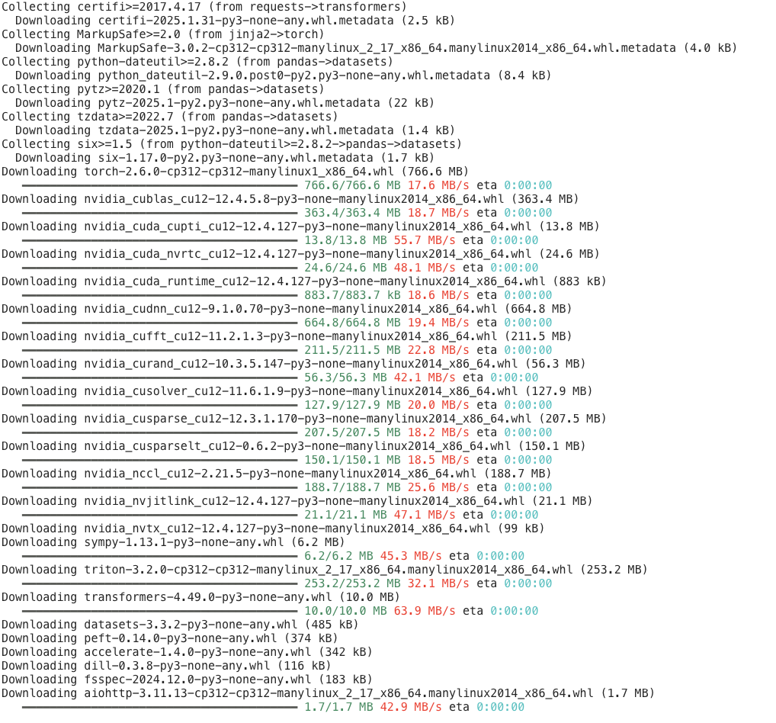
Installing

Slide 7
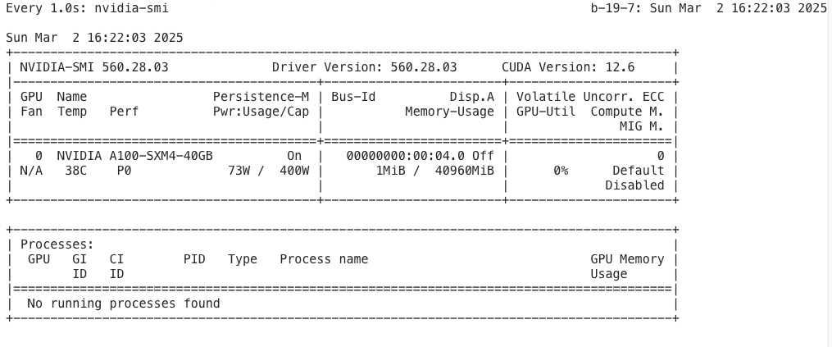
Ensure the container has access to GPUs:
watch -n 1 nvidia-smi

Slide 8
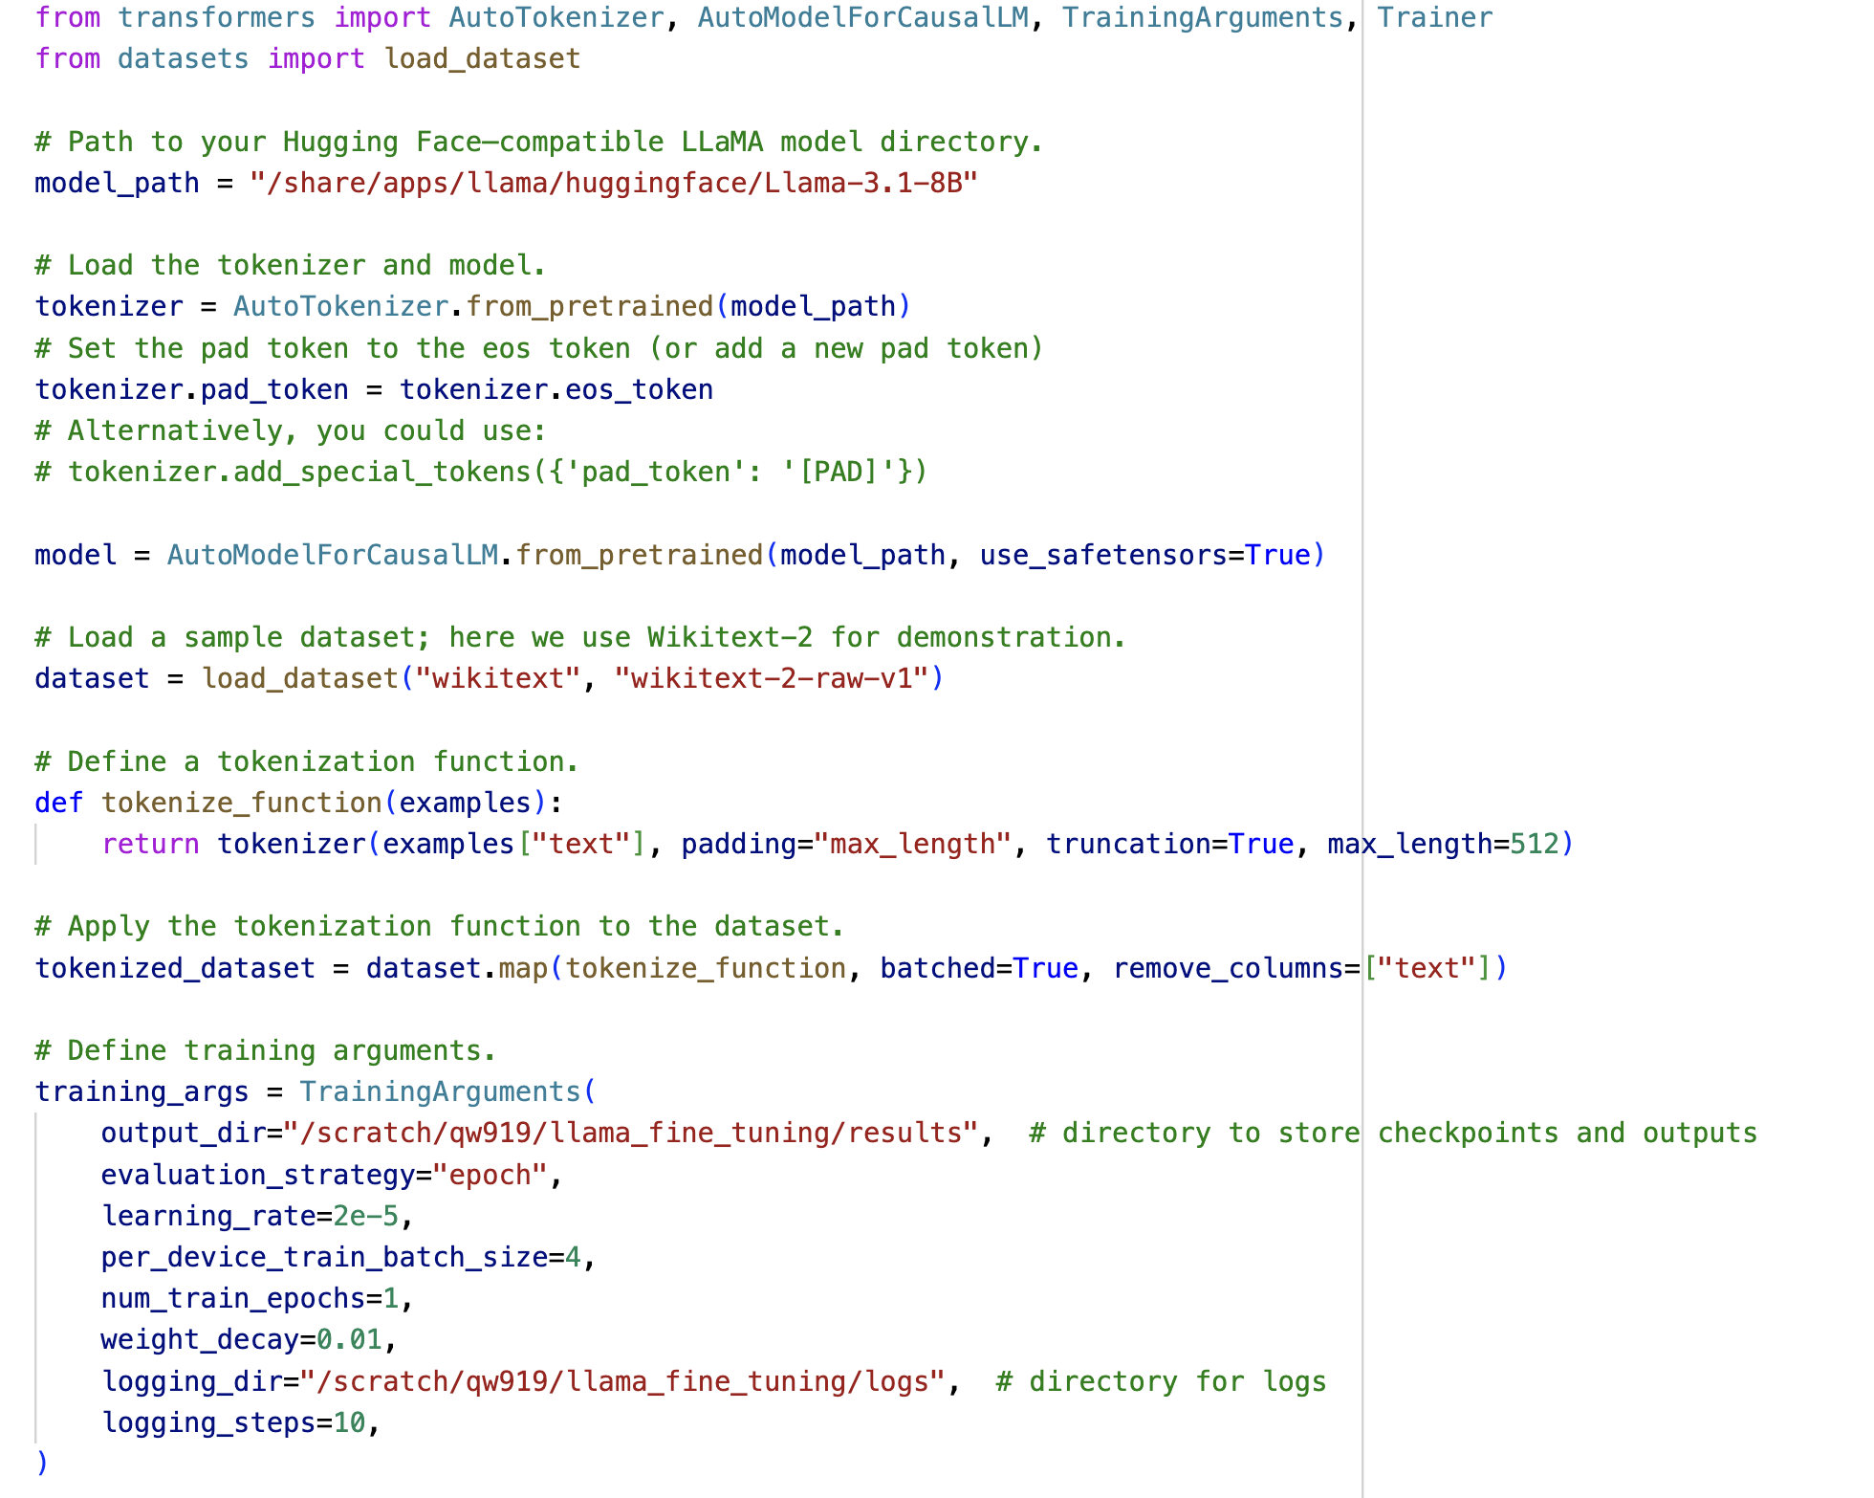
Next Step
Prepare a Fine-Tuning Script
Run the Fine-Tuning Script
python fine_tune_llama.py
OR
Submit as a Batch Job
sbatch fine_tune_llama.sbatch

Slide 9
Hyperparameters
Per-Device Train Batch Size (e.g., 4)
Guidelines:
This depends largely on your hardware, especially GPU memory.
Larger batch sizes can provide more stable gradient estimates but require more memory.
How to Choose:
Memory Constraints: If your GPU has limited memory, start with a smaller batch size.
Effective Batch Size: If you need a larger batch size but are memory-constrained, consider using gradient accumulation (e.g., accumulate gradients over several steps to simulate a larger batch size).
Empirical Testing: Monitor GPU usage and training stability; if training is unstable, a smaller batch size might help.
Learning Rate (e.g., 2e-5)
Guidelines:
Fine‑tuning large pre-trained language models typically requires a small learning rate, often in the range of 1e-5 to 5e-5.
A lower learning rate is usually safer for fine‑tuning because the model is already well‑initialized.
How to Choose:
Start with a common default: Many published papers and examples use 2e-5.
Learning Rate Schedules: Consider using a scheduler (e.g., linear decay with warmup) to adjust the learning rate during training.
Experimentation: If the model converges too slowly or shows unstable training, try adjusting the learning rate up or down.

Slide 10
Hyperparameters
Number of Training Epochs (e.g., 1)
Guidelines:
The optimal number of epochs depends on the size and nature of your dataset.
Fine‑tuning often requires fewer epochs than training from scratch.
How to Choose:
Dataset Size: For large datasets, even one epoch might be sufficient to adapt the model.
Validation Loss: Monitor validation metrics; if performance stops improving, more epochs may lead to overfitting.
Starting Point: Start with a small number (e.g., 1–3) and adjust based on observed performance.
Weight Decay (e.g., 0.01)
Guidelines:
Weight decay is used for regularization to prevent overfitting by penalizing large weights.
Values are usually small (often around 0.01).
How to Choose:
Default Value: 0.01 is a common starting point.
Regularization Needs: If you observe overfitting (training loss drops significantly but validation loss does not), consider increasing weight decay.
Experiment: Try a small range (e.g., 0.001, 0.01, 0.1) to see what works best for your task.

Slide 11
Hyperparameters
Evaluation Strategy (e.g., "epoch")
Guidelines:
Evaluation frequency determines how often you check the model's performance on a validation set.
How to Choose:
Task Dynamics: For tasks where performance changes quickly, you might evaluate more frequently (e.g., every few steps).
Epoch-Level Evaluation: Evaluating at the end of each epoch is common when you have a relatively stable training process.
Trade-off: More frequent evaluation can give you finer-grained monitoring but may slow down training.
Logging Steps (e.g., 10)
Guidelines:
Logging frequency should be frequent enough to monitor training progress but not so frequent that it overwhelms your output or slows down training.
How to Choose:
Training Speed: If your training steps are fast, logging every 10 steps might work well.
Monitoring Needs: Adjust this number based on how detailed you want your logs to be. You might start with 10 and change it based on the size of your dataset or batch processing time.

Slide 12
What does an sbatch script look like?
gpu_job.slurm
#SBATCH --job-name=example_in_lab
#SBATCH --account=ds_ga_1012-2025sp
#SBATCH --partition=n1s8-v100-1
#SBATCH --gres=gpu
#SBATCH --open-mode=append
#SBATCH --output=./%j_%x.out
#SBATCH --error=./%j_%x.err
#SBATCH --time=00:10:00
#SBATCH --mem=64G # perhaps try smaller mem if there's an error
#SBATCH -c 4
#SBATCH --requeue
singularity exec --nv --overlay $SCRATCH/overlay-25GB-500K.ext3:ro /scratch/[netid]/cuda11.4.2-cudnn8.2.4-devel-ubuntu20.04.3.sif /bin/bash -c "
source /ext3/env.sh
conda activate
python ./test_gpu.py
"
Now we submit the job using sbatch command and check how it is running using squeue command.
sbatch gpu_job.slurm
squeue -u [netid]
Notes:
https://gist.githubusercontent.com/uralik/2760833e55be112eda8352f831626419/raw/dd800529551cf0f698d3aca3bb6544076b5ece98/env.sh

Slide 13
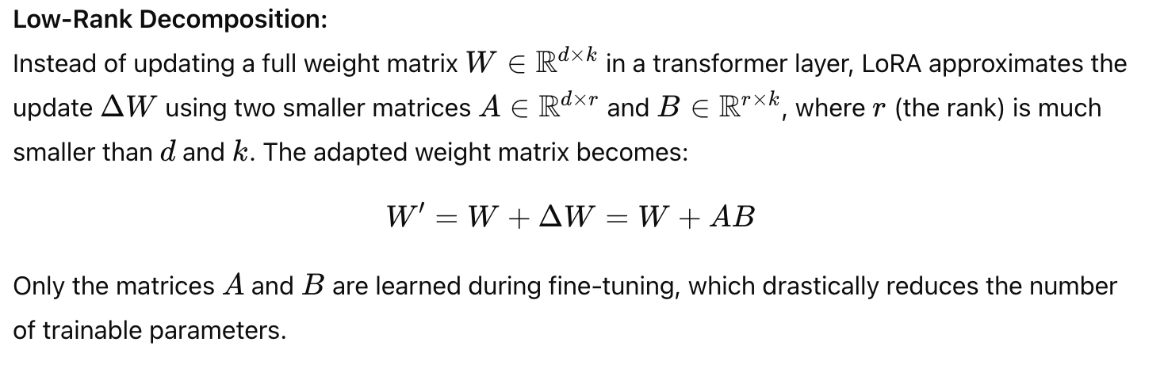
LoRA
Parameter-Efficient Fine-Tuning:
In traditional fine‑tuning, every parameter in a large model is adjusted for a new task, which can be extremely resource‑intensive. LoRA addresses this by keeping the original weights fixed (frozen) and learning a small set of additional parameters.

Slide 14
Why LoRA?
Reduced Compute and Memory Requirements: Since only the low-rank matrices are updated, the number of parameters to store gradients and compute updates is much smaller. This means you can fine‑tune very large models on hardware with limited memory.
Faster Training and Inference: Training becomes faster because the optimization process works on a much smaller set of parameters. Also, when deploying the model, you only need to store the adapter parameters in addition to the base model.
Preserving the Pre-Trained Model: The base model remains unchanged. This helps maintain the broad, general-purpose capabilities learned during pre‑training, while the small adapter learns task-specific adjustments.
Modularity: The LoRA adapters are “plug‑and‑play” modules. Once trained for a specific task, they can be applied to the base model without modifying the original weights, allowing you to easily switch between different fine‑tuned adaptations.

Slide 15
How LoRA Works in Transformers
Targeting Specific Layers:
In transformer architectures like LLaMA, the majority of parameters are found in the attention mechanism. LoRA is typically applied to the query (q) and value (v) projection matrices within the multi-head attention layers. These matrices have a large number of parameters, making them ideal candidates for low‑rank adaptation.
Implementation in Practice:
Libraries such as Hugging Face’s PEFT (Parameter-Efficient Fine-Tuning) provide a straightforward interface to apply LoRA. When you wrap your model with LoRA, the adapter layers are injected into the target layers, and during fine‑tuning, only these adapter parameters are updated.

Slide 16
How LoRA Works in Transformers
Hyperparameters:
Rank r: Determines the size of the low‑rank matrices A and B. A smaller r means fewer parameters are updated.
Scaling Factor lora_alphalora: Scales the contribution of the LoRA layers. This helps control the magnitude of the updates relative to the frozen pre-trained weights.
Dropout: Some implementations add dropout within the LoRA modules to help with regularization during fine‑tuning.

Slide 17
TEMPLATE NOTES
This template is part of the NYU Templates collection. Refer to our Usage Guidelines for help topics and quick tips on how to use this template.
Download the Grackle Slides add-on to automatically run accessibility checks on all aspects of your document and get advice on how to make things better.

